Slide 1
Chapter 19
Drifting Toward Disuion,
1854-1861

Slide 2
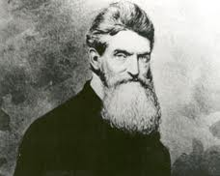
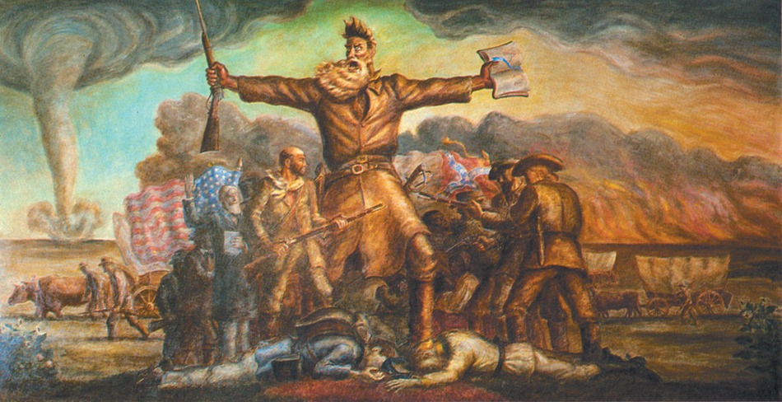
John Brown: Hero or Villain?
Harpers Ferry:
John Brown and followers seize an arsenal, killing 7 innocent people
Hoped to encourage a massive slave rebellion
Brown is convicted of murder and treason, hanged with followers
Effects of John Brown’s raid:
Becomes a martyr in the North to abolitionists
South becomes very fearful of future attacks
Believed northerners were all radical Republicans
Major immediate cause of disunion

Slide 3
The Disruption of the Democrats
Election of 1860, Democrats are split
Northerners favor Douglas
Southerners view him as a traitor
John C. Breckinridge:
Selected by Southern wing of Democrats
Favored extension of slavery into territories and annexation of Cuba
Constitutional Union Party:
Wanted to elect a compromise candidate

Slide 4
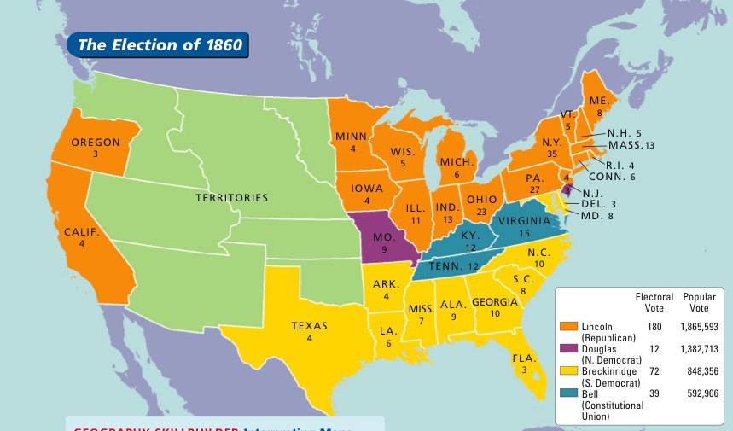
The Election of 1860
Lincoln wins, but is a “Minority” president
60% voted for someone else
Sectional president: not on ballot in 10 southern states
SC threatened to secede if Lincoln won; Charleston 1860 convention unanimously voted to secede
Shortly after, 11 states secede
February 1861: Confederate States of America
Buchanan was a “lame duck” president until March, 1861
Did not believe southern states could legally secede
Did not believe Constitution gave him authority to stop (plus Northern army not prepared)
Crittenden Amendment:
Aimed to appease the South
Slavery in territories was to be prohibited north of 36˚30’, but south of that line was to be given federal protection in all territories existing, or would exist (Cuba)
Lincoln rejects it

